Slide 1

George West,
a place to grow

Slide 2
Why
George West?
Heart of South Texas
Access to International Commerce
Major Highways and Rail Transportation
Existing Industrial Corridor
Low-Cost Land and Construction
Favorable Taxes and Permitting
Competitive Workforce
High Performing Schools
Deregulated Power / Abundant Natural Gas
No Natural Disasters
Great Recreation and Lifestyle

Slide 3
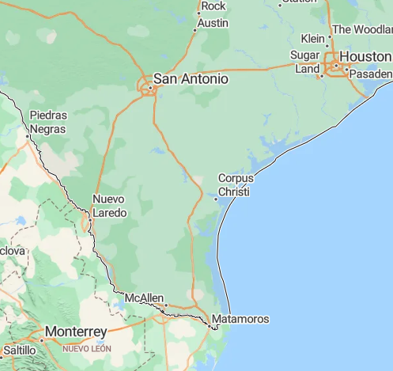

Heart of South Texas
Logistical Center of South Texas
3rd Largest Deep-Water Port in U.S. - 62 miles
1st Largest Inland Port in Western Hemisphere - 110 miles
4 Internation Airports within 3 hours
D
 | Distance from George West | Miles | Drive Time
A | Corpus Christi (Port) | 62 | 0:55
B | San Antonio | 84 | 1:17
C | Laredo (Port) | 108 | 1:58
D | Tesla Plant / Austin | 147 | 2:30
E | McAllen | 163 | 2:30
F | Houston (Port) | 208 | 3:20
G | SpaceX Launch Facility | 215 | 3:29
F
B
George West
A
C
E
G

Slide 4
International Transportation
Near Major Ports
Port |  | Value (billions) | Distance (miles)
Corpus Christi | #3 U.S. Deep Water Port | $88 B | 62
Laredo | #1 among U.S. border crossings #1 Inland Port in Western Hemisphere #3 of all U.S. ports of entry (air, sea, and land) #1 for USMCA trade 40% of all U.S. Mexico trade $1 billion worth of goods daily Railcar shipments: 213,000/yr (loaded) Commercial Truck Crossings: 6,000,000/yr 17,000/day | $360 B | 114
Houston | #1 U.S. port by foreign waterborne tonnage and ranks among the top container ports. Containerized, Steel, General, Bulk | $223 B | 238
n/a: Port Laredo is an Inland Port, therefore does not track tonnage.
USMCA – United States, Mexico and Canda trade pact (2020)
All figures are approximate.
Source: Port of Laredo Texas
Unites State Department of Transportation

Slide 5
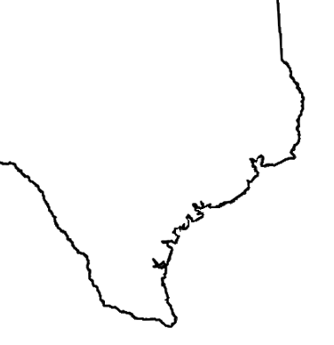

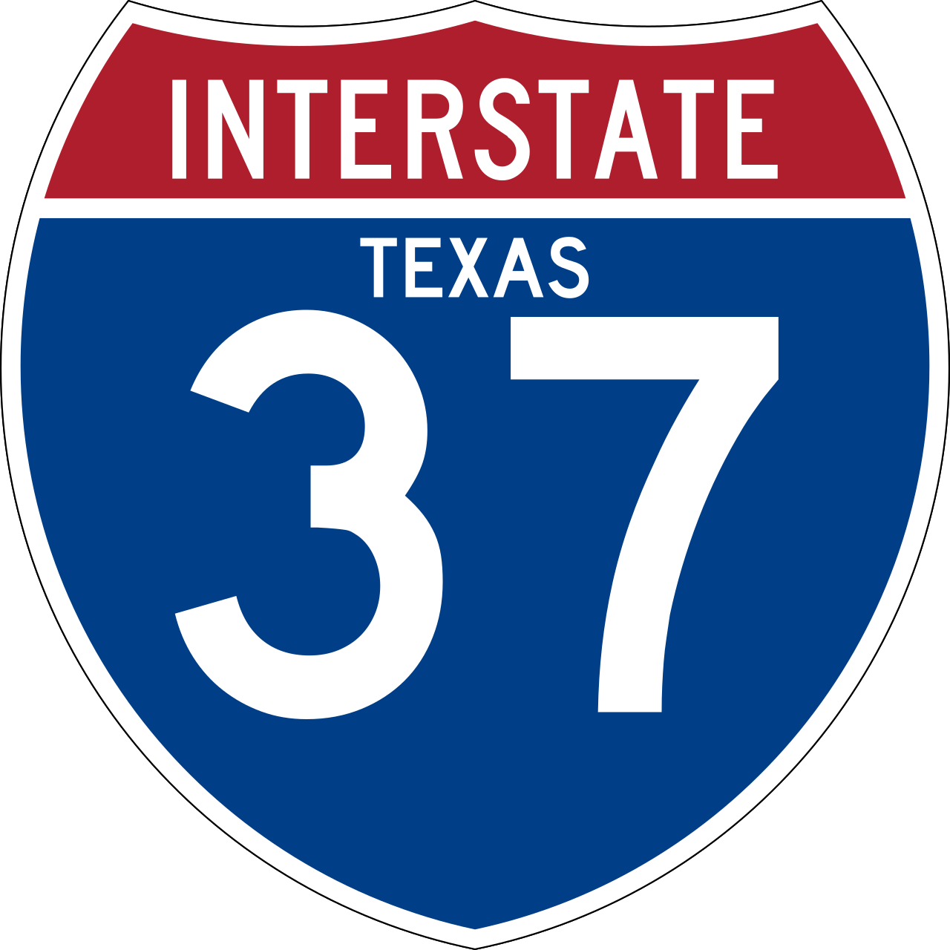
3 Major Highways
Excellent mobility for inbound and outbound freight
Ft Worth
Dallas
Prime FT and LTL Transportation Corridor:
Houston
San Antonio
Austin
Dallas / Ft Worth
Laredo
McAllen
Austin
San Antonio
Houston
George West
Laredo
Corpus Christi
McAllen

Slide 6


US & International Rail Access
Rail Access to Mexico and US
Union Pacific and CPKC – Class I Railroads
Union Pacific Service to:
Corpus Christi
Brownsville
San Antonio
Austin
Ft Worth
Dallas
Mexico
Canadian Pacific
Kansas City
Interconnect to:
Laredo
Mexico
Ft Worth
Dallas
Austin
San Antonio
Houston
George West
Laredo
Corpus Christi
Brownsville

Slide 7

Industrial Corridor
1 | Valero Refinery
2 | TG Fuels
3 | Howard Energy Partners - Maverick
4 | Live Oak Trailer / J-M Concrete
5 | Kinder Morgan Texas Pipelines
6 | Live Oak Rail Road - 5 rail sidings 20,000 ft
7 | Howard Energy Partners
8 | FCI Sand Operations
9 | Phillips 66 Gas Plant
10 | Stabilis
11 | T. I. E. Compressors
12 | Energy Transfer - Nueces Compressor
13 | TMI Solutions LLC
14 | Live Oak County Airport-General Aviation
15 | Energy Transfer - Rio Bravo Station
16 | Pawlik & Son Water Well Service
17 | FFM Process Piping Materials
18 | Reliant Field Services
19 | Gryphon ESP 24 Hour Fire and Rescue
20 | PICO Technologies LLC
21 | Tex-Isle Supply Inc
22 | Southern Tire Mart
23 | Energy Transfer - George West Office
24 | HP Propane & Fuel
25 | Union Truck Parts
26 | Moffit Custom Fuel Solutions
27 | Offshore Energy Services
27 | Badger Mining – 8 rail sidings 11,500 ft
28 | FLEXPIPE
29 | British Petroleum Eagle Ford Operations
30 | White Water Equipment
Businesses Succeed Here
Three Rivers
1
2
3
6
7
18
4
9
8
19
5
20
10
11
12
13
14
21
22
23
15
24
16
29
25
17
30
28
26
27
George West

Slide 8
Industrial Corridor
Name | Business |  | Revenue | Headquarters | Owner/Leader
Offshore Energy Services | Handling and installation of tubular products required during the drilling and completion phase of well construction |  | $156 M | Broussard, Louisiana | Private Family owns Charles M. Garber CEO
Tex-Isle Supply Inc | Structural Pipe Standard Pipe | Heat Treatment Threading External Coating Internal Coating | $123M | Houston, Texas | Private Family owned Chris Kayem as President
Howard Energy Partners | Midstream energy infrastructure across Texas, New Mexico, Pennsylvania, Oklahoma, Kansas, and Mexico |  | $371 M | San Antonio, Texas | Private Mike Howard is the founder, Chairman, and CEO
PICO Technologies LLC | Test and measurement equipment, PC oscilloscopes, and data loggers. Services including flowback and well testing, gas compression services, and production optimization |  | $49 M | Houston, Texas | Private Private equity Golden Gate Capital Jarrod Yuster CEO
Estimated Annual Revenue – Private Companies do not publish revenue/earnings.

Slide 9
Low-Cost Land and Construction
Favorable Permitting
Construction Costs
24% below the national average
Source: Maxx Builders (Houston)

Slide 10
Low Taxes
60% below national average
Live Oak County lower than 220 counties in Texas
New York
Highest Rate
Live Oak
County
Average of All
Texas Counties
Highest
County
Texas¹
Average of All
States
Note: ¹ Texas has a Franchise Tax. Effective Tax Rate (shown) includes state and local taxes.
source: Rich States, Poor States (2025)

Slide 11
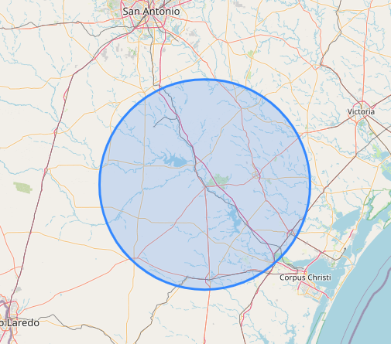
Labor Workforce
Source:
Big Radius Tool
Global Human Settlement Layer
Workforce 38,900
Competitive Wages
Average wage is 20% below the national average
Radius (miles) | Population | Workforce | Employment | Avg. Earnings per Job | Unemployment Rate | Drive Time
25 | 44,988 | 14,204 | 13,511 | $58,543 | 4.9% | 20
50 | 108,212 | 38,932 | 37,001 | $57,066 | 5.0% | 45
75 | 758,000 | 338,843 | 323,625 | $63,521 | 4.5% | 60
100 | 3,550,725 | 1,684,742 | 1,614,034 | $67,606 | 4.2% | 90
Source: U.S. Economic Development Administration
U.S. National Average Earnings = $69,505
source: Social Security Administration

Slide 12
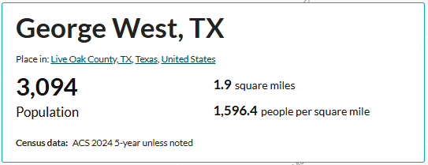
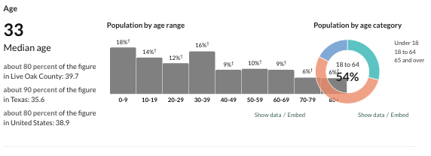
Demographics
Growing Population +39%
County Seat – Live Oak County
Population increased by 39% since 2020 census (2025 estimate by US Census Bureau)
Live expectancy 77.2 years (same as national avg. 77.6 years)

Slide 13
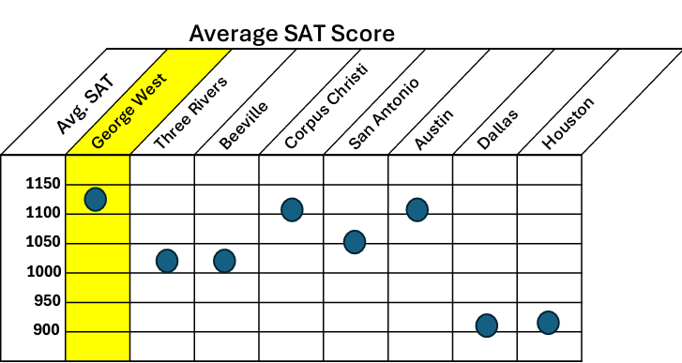
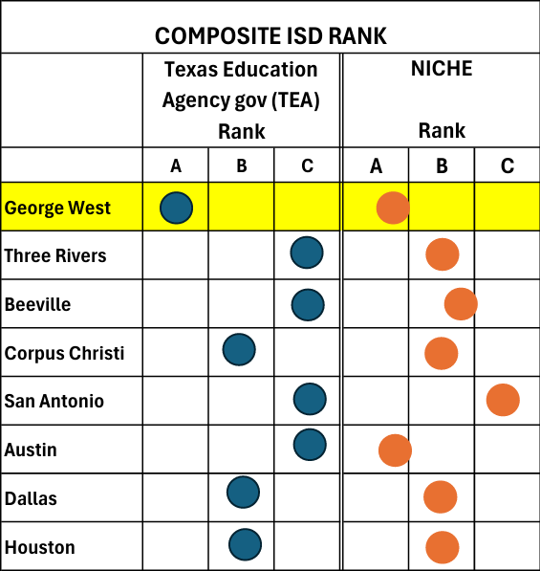
George West Education
High Performing Schools
source:
Texas Education Agency (TEA) ranking
NICHE A prominent national ranking organization headquartered in Pittsburg, Pennsylvania.

Slide 14
Low-Cost Electric Rates
Texas Ranks 3rd Lowest Electric Rates in US
3rd lowest electric rates in U.S.
Texas
US High state rate excludes Hawaii from data set
14
source: US Energy Information Administration (DoE) May 2026

Slide 15
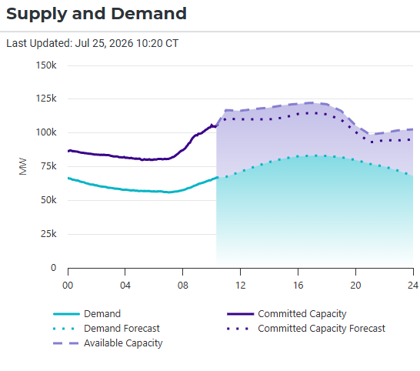
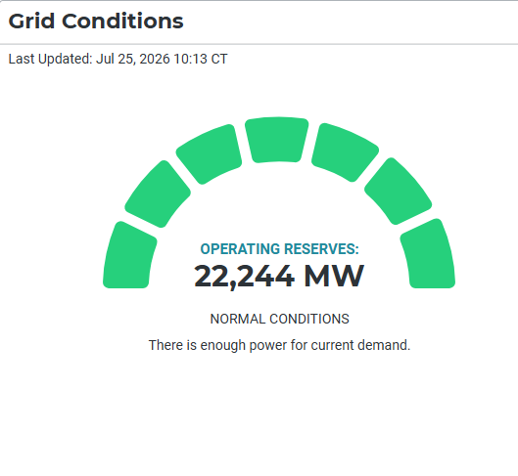
Reliable Electric / Excess Capacity
Texas Maintains Surplus Power Reserves
TEXAS ALL-TIME RECORD DEMAND (source: ERCOT)
July 22, 2026
Peak demand = 91,303 MW
Available capacity = 113,529 MW
Reserves = 22,226 MW (20%)
ERCOT
ERCOT
15
ERCOT – Electrical Reliability Council of Texas

Slide 16
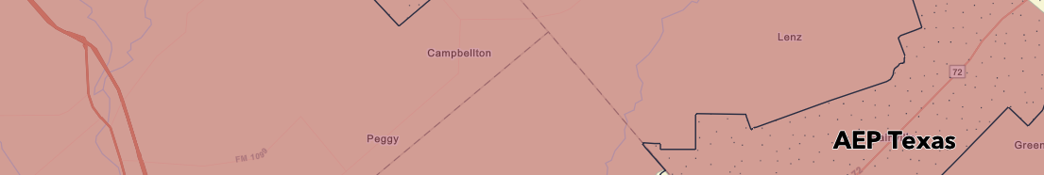
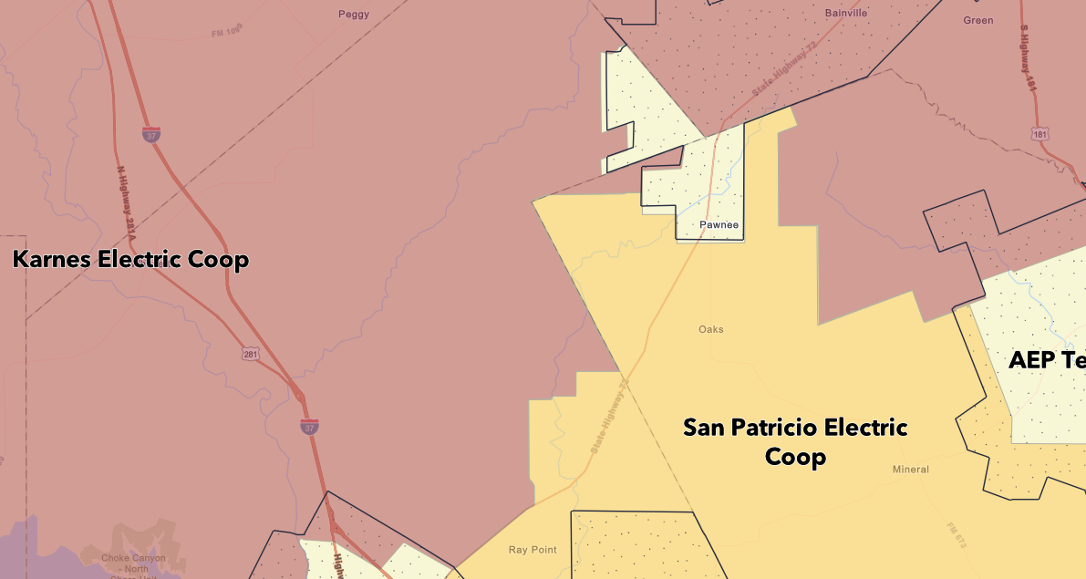
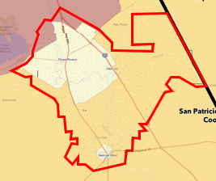
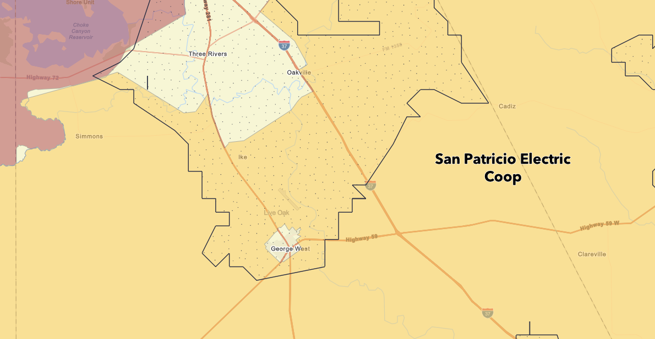
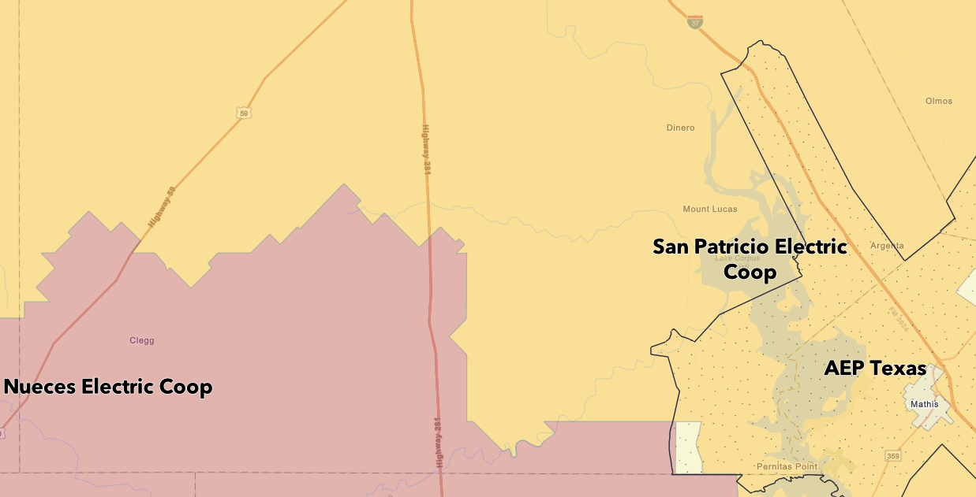
Deregulated Power
Large Buyers Can Negotiate Electric Rates
Dual Certification Area
AEP Texas (red Line) - deregulated
San Patricio (yellow) – not deregulated
AEP
Deregulated Electricity
.
AEP
AEP
Deregulated Electricity
AEP
16
source: Public Utility of Texas

Slide 17
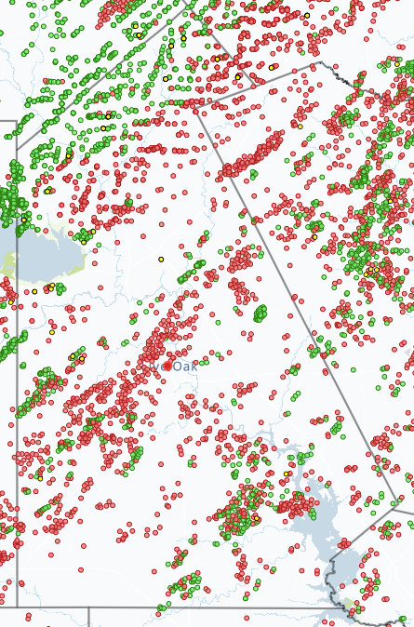
Abundant Natural Gas
148,697,124,000 cu ft Live Oak County Annual Gas Production
20,040,000 MWh Electric Power Equivalent
Oil Well
Gas Well
148,697,124,000 cu ft
source: Texas Railroad Commission (TRC) annualized April 2026 data
7,420 cu ft natural gas per MWh – U.S. Energy Information Agency

Slide 18
Natural Disasters – Very Low
Overall Rating by FEMA
Event | FEMA Risk Level
Over-All Index | Very Low
Tornado | Relatively low
Earthquake | Very low
Lightening | Very low
Hurricane | Relatively Low
Ice Storm | Relatively Low
Wild Fire | Very Low
Drought | Relatively Moderate
Heat | Relatively Low
Winter Weather | Very Low
Very Low
Risk Index
Important Site Selection Criteria For:
Disaster Recovery
Data Centers
Semi Conductor Production
Pharmaceutical Production
others
Data Source: United States. Federal Emergency Management Agency. National Risk Index for Natural Hazards (NRI), (Released December 2025)

Slide 19

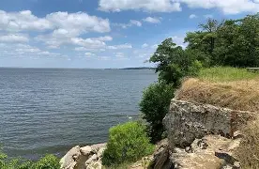
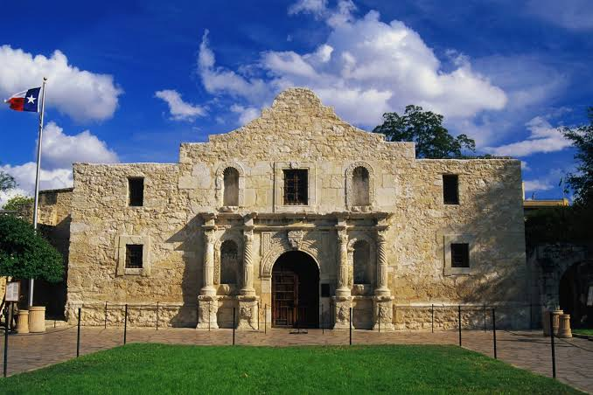
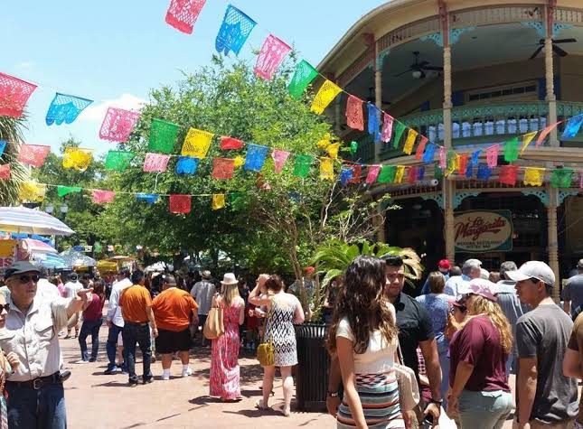
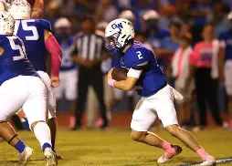
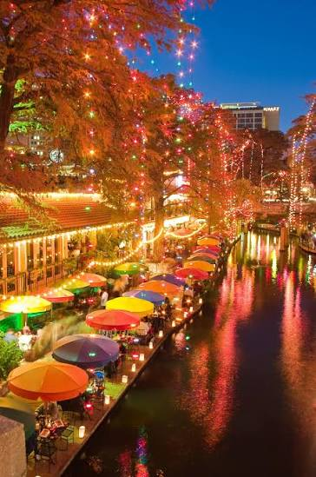

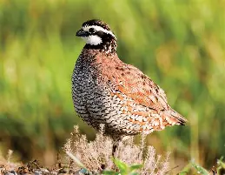

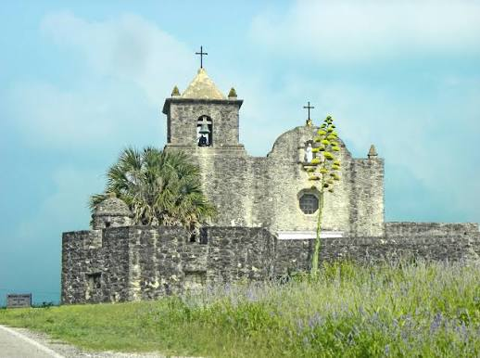
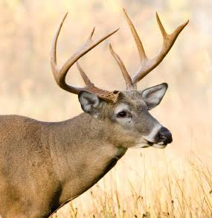
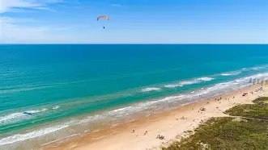
Recreation and Lifestyle
It’s a great place to live!
Choke Canyon State Park and Reservoir Nueces River Gulf Coast, beaches, fishing, boating and dining 60 miles South Padre Island | Sports, Spurs, Hooks MiLB Alamo, shopping, Riverwalk, El Mercado dinning 90 miles Golf/tennis Mesquite Golf Course, Beeville Country Club

Slide 20
Why
George West?
  Heart of South Texas
1
  International Transportation
2
  Major Interstate & Highways
  Class I Railroads
  Seaport 60 miles
  Inland Port & Mexico 100 miles
  Low Costs
3
  Construction 24% Below Nat Avg
  Taxes 60% Below National Avg
  Electric 27% Below National Avg
  Labor 20% Below National Avg
  Businesses Succeed Here
  No Natural Disasters
4
  Great Recreation and Lifestyle
5

